Slide 1
Data structure

Slide 2
What is Data Structure
Data Structure can be defined as the group of data elements which provides an efficient way of storing and organizing data in the computer so that it can be used efficiently.
examples of Data Structures are arrays, Linked List, Stack, Queue, etc.
Data Structures are widely used in almost every aspect of Computer Science i.e. Operating System, Compiler Design, Artificial intelligence, Graphics and many more.
Data Structures are the main part of many computer science algorithms as they enable the programmers to handle the data in an efficient way.
It plays a vital role in enhancing the performance of a software or a program as the main function of the software is to store and retrieve the user’s data as fast as possible
Data Structure= Organized Data + Allowed Operations

Slide 3
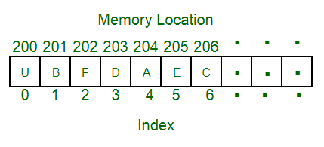
Data Structure
A data structure is a particular way of organizing data in a computer so that it can be used effectively.
For example, we can store a list of items having the same data-type using the array data structure.

Slide 4
The representation of particular data structure in the main memory of a computer is called as storage structure.
The storage structure representation in auxiliary memory is called as file structure.
It is define as the way of storing and manipulating data in organized form so that it can be used efficiently
Data Structure mainly specifies the following four things:
1)organization of data 2)accessing method 3)degree of associativity 4) processing alternative for information
Algorithm + Data Structure = Program
Data Structure study Covers the following points
1) Amount of memory require to store
2) Amount of time require to process
3) Representation of data in memory
4) Operations performs on data

Slide 5
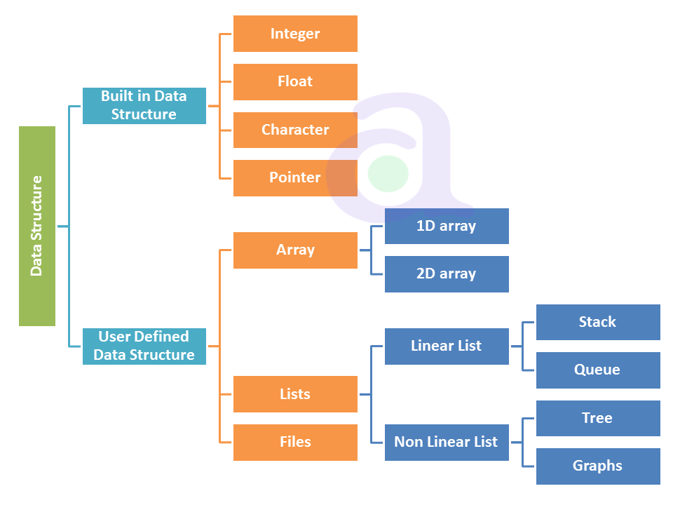
Types Of DS
The DS are divided into two types:
Primitive
Non primitive
Non primitive divided into two type
Linear DS
Non linear DS

Slide 6
Applications of DS
Arrays
Arrangement of leader-board of a game can be done simply through arrays to store the score and arrange them in descending order to clearly make out the rank of each player in the game.
2D arrays, commonly known as, matrix, are used in image processing.
It is also used in speech processing, in which each speech signal is an array.

Slide 7
Applications of the linked list
Images are linked with each other. So, an image viewer software uses a linked list to view the previous and the next images using the previous and next buttons.
Web pages can be accessed using the previous and the next URL links which are linked using linked list.
The music players also use the same technique to switch between music.
To keep the track of turns in a multi player game, a circular linked list is used.

Slide 8
Applications of a stack
Some Applications of a stack are:
Converting infix to postfix expressions.
Undo operation is also carried out through stacks.
Syntaxes in languages are parsed using stacks.
It is used in many virtual machines like JVM.
Forward – backward surfing in browser
History of visited websites
Message logs and all messages you get are arranged in stack
Call logs, E-mails, Google photos’ any gallery , YouTube downloads, Notifications ( latest appears first )

Slide 9
Applications of Queue
Operating System uses queue for job scheduling.
To handle congestion in networking queue can be used.
Data packets in communication are arranged in queue format.
Sending an E-mail, it will be queued
server while responding request
Uploading and downloading photo’s, first kept for uploading/downloading will completed first (Not if there is threading)
Most of internet requests and processes uses queue
While switching multiple applications, windows uses circular queue.

Slide 10
Applications of a Graph
Facebook’s Graph API uses the structure of Graphs. (The Graph API is the primary way to get data into and out of the Facebook platform. It's an HTTP-based API that apps can use to programmatically query data, post new stories, manage ads, upload photos, and perform a wide variety of other tasks.)
Google’s Knowledge Graph also has to do something with Graph. ( knowledge base that represents semantic relations between concepts in a network.)
Dijkstra algorithm or the shortest path first algorithm also uses graph structure to finding the smallest path between the nodes of the graph.
GPS navigation system also uses shortest path APIs.
Networking components has huge application of graph
Facebook, Instagram and all social media networking sites every user is Node
Data organization
Notes:
The Graph API is named after the idea of a "social graph" — a representation of the information on Facebook. It's composed of nodes, edges, and fields. Typically you use nodes to get data about a specific object, use edges to get collections of objects on a single object, and use fields to get data about a single object or each object in a collection.

Slide 11
Applications of the trees
XML Parser uses tree algorithms.
Decision-based algorithm is used in machine learning which works upon the algorithm of tree.
Databases also uses tree data structures for indexing.
Domain Name Server(DNS) also uses tree structures.
File explorer/my computer of mobile/any computer
BST used in computer Graphics
Posting questions on websites like Quora, the comments are child of questions
Notes:
https://www.2braces.com/c-questions/for-loop-questions-c-3

Slide 12
DATA TYPES A particular kind of data item, as defined by the values it can take, the Programming language used, or the operations that can be performed on it.
Primitive Data Structure
Primitive Data Structure are basic structure and directly operated upon by machine instructions.
Primitive data structures have different representations on different computers.
Integers, floats, character and pointers are example of primitive data structures.
These data types are available in most programming languages as built in type.
Integer: It is a data type which allows all values without fraction part. We can used it for whole numbers.
Float: It is a data type which is use for storing fraction numbers.
Character: It is a data type which is used for character values.
Pointer: A variable that hold memory address of another variable are called pointer.

Slide 13
Non Primitive Data Type
These are more sophisticated data structures.
These are derived from primitive data structure.
The non – primitive data structures emphasize structuring of a group of homogeneous or heterogeneous data items.
Example of non – primitive data types are Array, List, and File etc.
A non – primitive data type is further divided into Linear and non – Linear data structure.
Array: An array is a fixed size sequenced collection of elements of the same data type.
List: An ordered set containing variable number of elements is called as List.
File: A file is a collection of logically related information. It can be viewed as a large list of records consisting of various fields.

Slide 14
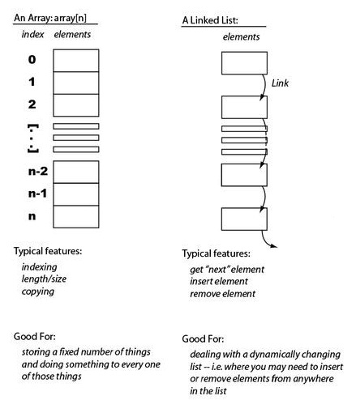
Linear Data Structures
A linear data structure simply means that it is a storage format of the data in the memory in which the data are arranged in contiguous blocks of memory.
Example is the array of characters it represented by one character after another.
In the linear data structure, member elements form a sequence in the storage.
There are two ways to represent a linear data structure in memory.
static memory allocation
dynamic memory allocation
The possible operations on the linear data structure are:
1) Traversing 2) Insertion 3) Deletion 4) searching 5) sorting
6) merging

Slide 15
Linear List

Slide 17
List Operations:
• Traversal: Traversal of a data structure means processing all the data elements of it,
sequentlly.
• Insertion: Insertion means addition of a new data element in a data structure.
• Deletion: Deletion means removal of a data element from a data structure. The data element
is searched for before its removal.
• Searching: Searching involves searching for the specified data element in a data structure.
• Sorting: Arranging data elements of a data structure in a specified order is called sorting.
• Merging: Combining elements of two similar data structures to form a new data structure of same type, is called merging.

Slide 18
Algorithm InsertLA (DATA, N, ITEM, LOC)
Desc: This algorithm inserts new element ITEM in linear array DATA with N elements
If LOC=1 it means the element has to insert in beginning
If LOC =N+1 it means the element have to be inserted at the end
If LOC = J it means the elements have to be inserted at Jth Location
Begin
Step 1: [Initialize counter I with index of last element]
I=N
Step 2: While I>=LOC repeat steps 3 and 4
Step 3: [Move the current element one position backwards]
DATA[I+1]=DATA[I]
Step 4: [Decrement counter I]
I=I-1
Step 5:[Insert new element at the Location]
DATA[LOC]=ITEM
Step 6:[ Update total under of array elements]
N=N+1
Exit
Notes:
https://csveda.com/data-structure/insertion-in-linear-array/

Slide 19
It is a process of deleting a particular element from an array. If an element to be deleted ith location then all elements from the (i+1)th location we have to be shifted one step towards left. So (i+1)th element is copied to ith location and (i+2)th to (i+1)th location and so on.
Algorithm: In this algorithm a value is being deleted from ith location of an array Reg[N]. Let us assume that last element in the array is at Mth position.
Steps
1. Back=i
2. While (Back<M) repeat 3 and 4
3. Reg[Back]= Reg[Back+1]
4. Back= Back+1
5. M=M-1
6. End

Slide 20
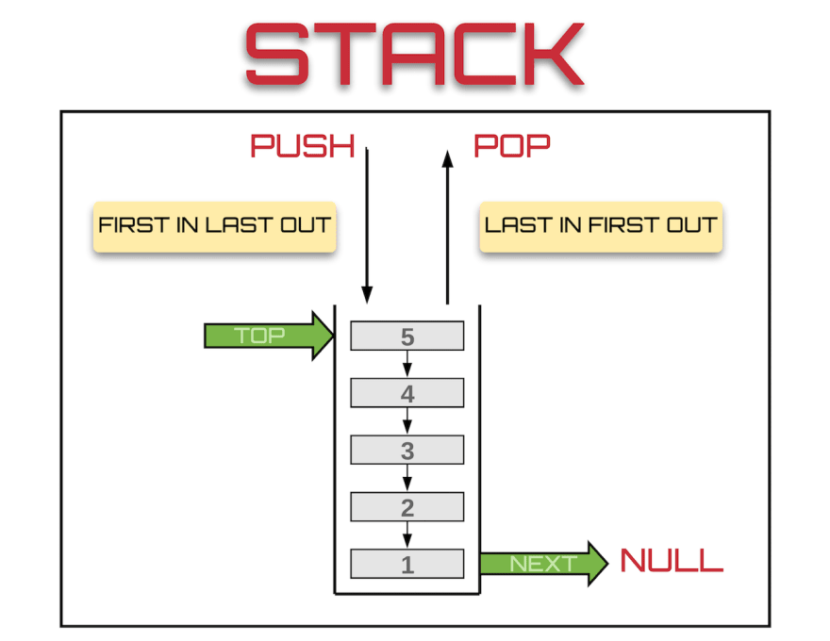
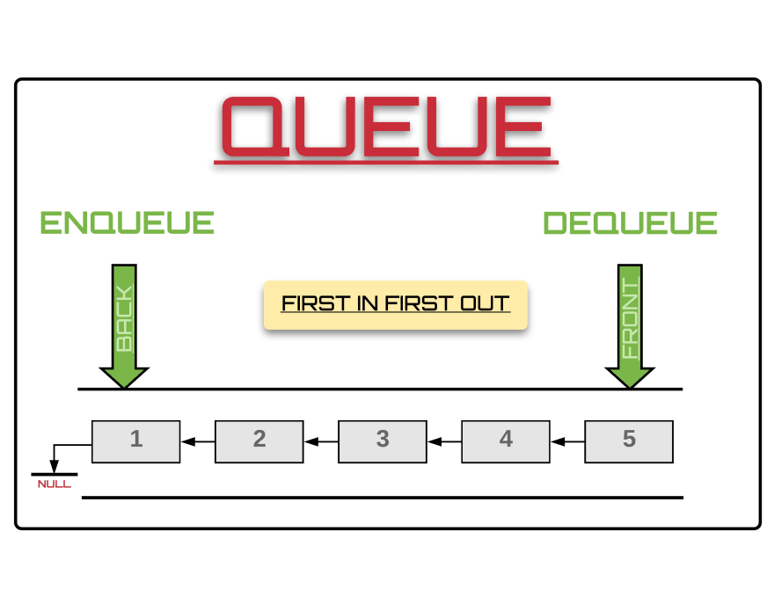
Example of Linear data structure are Stack and Queue
Stack
Stack is a data structure in which insertion and deletion operations are performed at one end only.
The insertion operation is referred to as ‘PUSH’ and deletion is referred as ‘POP’ operation
Stack is also called as Last In First Out (LIFO) data structure.
Queue
The data structure which permits the insertion at one and deletion at another end, known as Queue.
End at which deletion is occurs is known as FRONT end and another end at which insertion occurs is known as REAR end.
Queue is also called as First In First Out (FIFO)

Slide 21
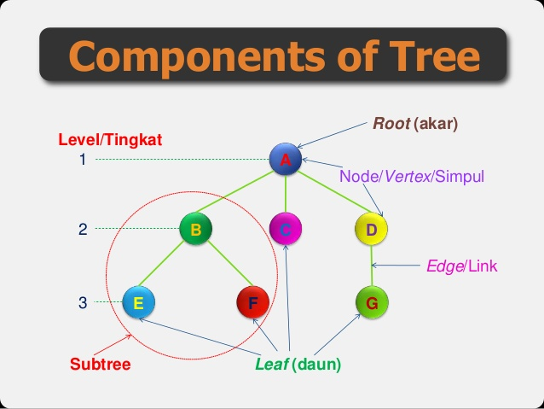

Non-Linear Data Structure
Non linear DS are those data structure in which data items are not arranged in a sequence.
Example on Non Linear DS are Tree and Graph.
TREE
A Tree can be define as finite data items (nodes) in which data items are arranged in branches and sub branches
Tree represent the hierarchical relationship between various elements
Tree consist of nodes connected by edge, the represented by circle and edge lives connecting to circle.
Graph
Graph is collection of nodes (information) and connecting edges (Logical relation) between nodes.
A tree can be viewed as restricted graph
Graph have many types: 1) Simple graph 2) Mixed graph 3) Multi graph 4) Directed graph 5) Un-directed graph
Components of Graph

Slide 22
Difference Between Linear and Non Linear Data Structure
Linear Data Structure
Non – Linear Data Structure
Every item is related to its previous and next item.
Data is arranged in linear sequence.
Data items can be traversed in a single run
E.g. Array, Stacks, Linked list, Queue
Implementation is easy.
Every item is attached with many other items.
Data is not arranged in sequence.
Data cannot be traversed in a single run.
E.g. Tree, Graph
Implementation is difficult.

Slide 23
Operation on Data Structures Design of efficient data structure must take operations to be performed on the DS into account. The most commonly used operations on DS are broadly categorized into following types
Create: This operation results in reserving memory for program elements. This can be done by declaration statement Creation of DS may take place either during compile-time or run-time.
Destroy: This operation destroy memory space allocated for specified data structure .
Selection: This operation deals with accessing a particular data within a data structure.
Updation: It updates or modifies the data in the data structure.
Searching: It finds the presence of desired data item in the list of data items, it may also find locations of all elements that satisfy certain conditions.
Sorting: This is a process of arranging all data items in a DS in particular order, for example either ascending order or in descending order.
Splitting: It is a process of partitioning single list to multiple list.
Merging: It is a process of combining data items of two different sorted list into single sorted list.
Traversing: It is a process of visiting each and every node of a list in systematic manner.

Slide 24
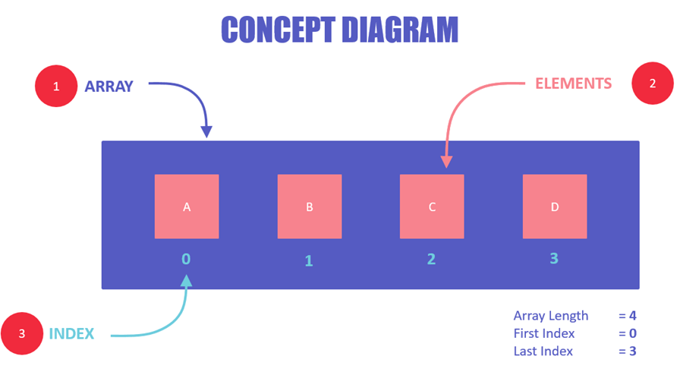
What are Arrays?
Array is a container which can hold a fix number of items and these items should be of the same type.
Most of the data structures make use of arrays to implement their algorithms.
Following are the important terms to understand the concept of Array.
Element − Each item stored in an array is called an element.
Index − Each location of an element in an array has a numerical index, which is used to identify the element.
An array is a container of elements.
Elements have a specific value and data type, like "ABC", TRUE or FALSE, etc.
Each element also has its own index, which is used to access the element.

Slide 25
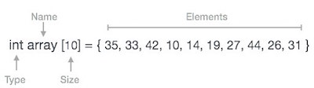
Array Representation
Arrays can be declared in various ways in different languages. For illustration, let's take C array declaration.

Slide 26
Quicksort
Quick sort is a fast sorting algorithm used to sort a list of elements. Quick sort algorithm is invented by C. A. R. Hoare.
The quick sort algorithm attempts to separate the list of elements into two parts and then sort each part recursively. That means it use divide and conquer strategy.
In quick sort, the partition of the list is performed based on the element called pivot. Here pivot element is one of the elements in the list.
The list is divided into two partitions such that "all elements to the left of pivot are smaller than the pivot and all elements to the right of pivot are greater than or equal to the pivot".

Slide 27
Step by Step Process
In Quick sort algorithm, partitioning of the list is performed using following steps...
Step 1 - Consider the first element of the list as pivot (i.e., Element at first position in the list).
Step 2 - Define two variables i and j. Set i and j to first and last elements of the list respectively.
Step 3 - Increment i until list[i] > pivot then stop.
Step 4 - Decrement j until list[j] < pivot then stop.
Step 5 - If i < j then exchange list[i] and list[j].
Step 6 - Repeat steps 3,4 & 5 until i > j.
Step 7 - Exchange the pivot element with list[j] element.

Slide 28
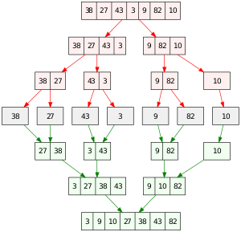
Merge sort

Slide 29
Linked List
A linked list is a non-sequential collection of data items. It is a dynamic data structure. For every data item in a linked list, there is an associated pointer that would give the memory location of the next data item in the linked list.
The data items in the linked list are not in consecutive memory locations. They may be anywhere, but the accessing of these data items is easier as each data item contains the address of the next data item.

Slide 30
Advantages of linked lists
1. Linked lists are dynamic data structures. i.e., they can grow or shrink during the execution of a program.
2. Linked lists have efficient memory utilization. Here, memory is not preallocated. Memory is allocated whenever it is required and it is de-allocated (removed) when it is no longer needed.
3. Insertion and Deletions are easier and efficient. Linked lists provide flexibility in inserting a data item at a specified position and deletion of the data item from the given position.
4. Many complex applications can be easily carried out with linked lists.

Slide 31
Disadvantages of linked lists
It consumes more space because every node requires a additional pointer to store address of the next node.
2. Searching a particular element in list is difficult and also time consuming.

Slide 32
Types of Linked Lists
Single Linked List.
Double Linked List.
Circular Linked List.
Circular Double Linked List.

Slide 33
A single linked list is one in which all nodes are linked together in some sequential manner. Hence, it is also called as linear linked list.
A double linked list is one in which all nodes are linked together by multiple links which helps in accessing both the successor node (next node) and predecessor node (previous node) from any arbitrary node within the list. Therefore each node in a double linked list has two link fields (pointers) to point to the left node (previous) and the right node (next). This helps to traverse in forward direction and backward direction.
A circular linked list is one, which has no beginning and no end. A single linked list can be made a circular linked list by simply storing address of the very first node in the link field of the last node.
A circular double linked list is one, which has both the successor pointer and predecessor pointer in the circular manner.

Slide 34
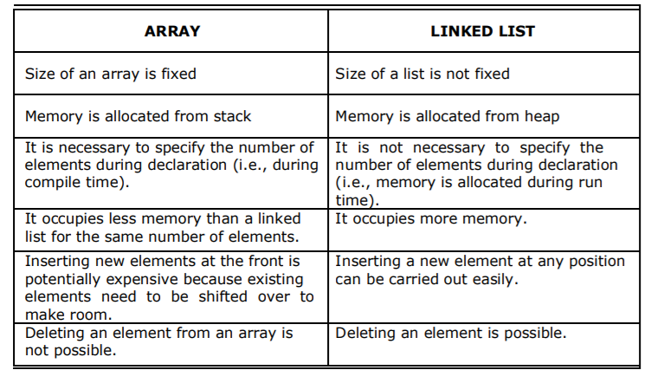
Comparison between array and linked list

Slide 35

Applications of linked list
1. Linked lists are used to represent and manipulate polynomial. Polynomials are expression containing terms with non zero coefficient and exponents. For
example:
2. Represent very large numbers and operations of the large number such as addition, multiplication and division.
3. Linked lists are to implement stack, queue, trees and graphs.
4. Implement the symbol table in compiler construction
struct node
{
int coeff,pow;
struct node *next;
}
Notes:
https://scitech105.blogspot.com/2016/03/c-program-to-implement-polynomial.html

Slide 36
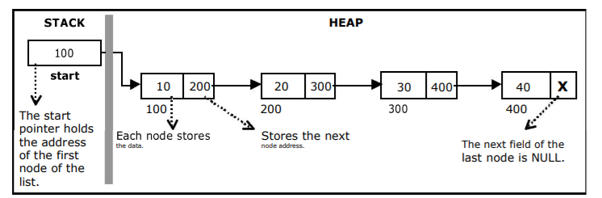
Single Linked List

Slide 37
Implementation of Single Linked List
Before writing the code to build the above list, we need to create a start node, used to create and access other nodes in the linked list.
Creating a structure with one data item and a next pointer, which will be pointing to next node of the list. This is called as self-referential structure.
Initialize the start pointer to be NULL.

Slide 38
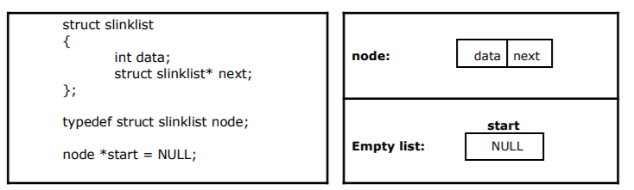

Slide 39
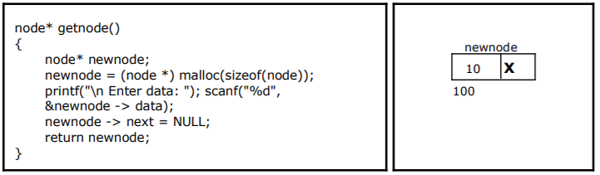
Creating a node for Single Linked List

Slide 40
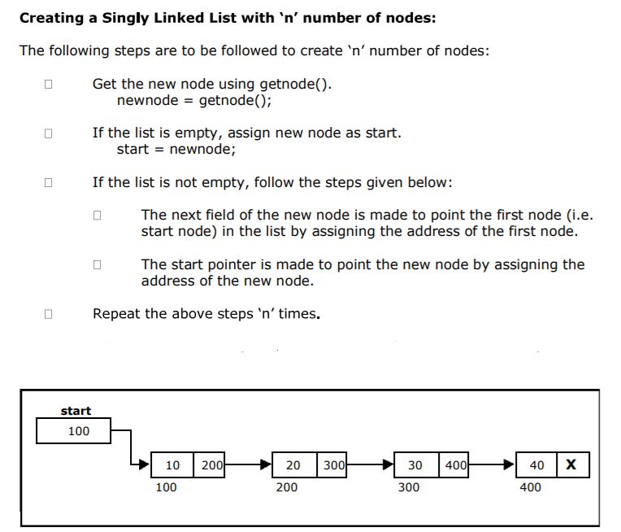

Slide 41
void createlist(int n)
{
int i;
node * new node;
node *temp;
for(i = 0; i < n ; i+ +)
{
new node = getnode();
if(start = = NULL)
{
start = new node;
}
else
{
temp = start;
while(temp - > next != NULL)
temp = temp - > next;
temp - > next = new node;
}
}
}

Slide 42
Insertion of a Node
Inserting a node at the beginning.
Inserting a node at the end.
Inserting a node at intermediate position.
Inserting a node at the beginning:
The following steps are to be followed to insert a new node at the beginning of the list:
Get the new node using getnode().
newnode = getnode();
If the list is empty then start = newnode.
If the list is not empty, follow the steps given below:
newnode -> next = start;
start = newnode;

Slide 43
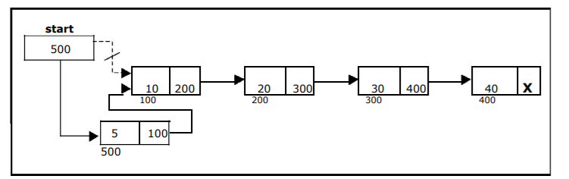
void insert_at_beg()
{
node *newnode;
newnode = getnode();
if(start == NULL)
{
start = newnode;
}
else
{
newnode -> next = start;
start = newnode;
}
}

Slide 44
Inserting a node at the end
void insert_at_end()
{
node *newnode, *temp;
newnode = getnode();
if(start == NULL)
{
start = newnode;
}
else
{
temp = start;
while(temp -> next != NULL)
temp = temp -> next;
temp -> next = newnode;
}
}
The following steps are followed to insert a new node at the end of the list:
Get the new node using getnode()
newnode = getnode();
If the list is empty then start = newnode.
If the list is not empty follow the steps given below:
temp = start;
while(temp -> next != NULL)
temp = temp -> next;
temp -> next = newnode;

Slide 45
Inserting a node at intermediate position
Get the new node using getnode().
newnode = getnode();
Ensure that the specified position is in between first node and last node. If not, specified position is invalid. This is done by countnode() function.
Store the starting address (which is in start pointer) in temp and prev
pointers. Then traverse the temp pointer upto the specified position followed
by prev pointer.
After reaching the specified position, follow the steps given below:
prev -> next = newnode;
newnode -> next = temp;

Slide 46
void insert_at_mid()
{
node *newnode, *temp, *prev;
int pos, nodectr, ctr = 1;
newnode = getnode();
printf("\n Enter the position: ");
scanf("%d", &pos);
nodectr = countnode(start);
if(pos > 1 && pos < nodectr)
{
temp = prev = start;
while(ctr < pos)
{
prev = temp;
temp = temp -> next;
ctr++;
}
prev -> next = newnode;
newnode -> next = temp;
}
else
{
printf("position %d is not a middle position", pos);
}
}

Slide 47
Deletion of a node
Another primitive operation that can be done in a singly linked list is the deletion of a node. Memory is to be released for the node to be deleted. A node can be deleted from the list from three different places namely.
Deleting a node at the beginning.
Deleting a node at the end.
Deleting a node at intermediate position

Slide 48
Deleting a node at the beginning
void delete_at_beg()
{
node *temp;
if(start == NULL)
{
printf("\n No nodes are exist..");
return ;
}
else
{
temp = start;
start = temp -> next;
free(temp);
printf("\n Node deleted ");
}
}
The following steps are followed, to delete a node at the beginning of the list:
If the list is not empty, follow the steps given below:
temp = start;
start = start -> next;
free(temp);

Slide 49
Deleting a node at the end
void delete_at_last()
{
node *temp, *prev;
if(start == NULL)
{
printf("\n Empty List..");
return ;
}
else
{
temp = start;
prev = start;
while(temp -> next != NULL)
{
prev = temp;
temp = temp -> next;
}
prev -> next = NULL;
free(temp);
printf("\n Node deleted ");
}
}
The following steps are followed to delete a node at the end of the list:
If the list is empty, display error message
If the list is not empty, follow the steps given below:
temp = prev = start;
while(temp -> next != NULL)
{
prev = temp;
temp = temp -> next;
}
prev -> next = NULL;
free(temp);

Slide 50
Deleting a node at Intermediate position
If the list is empty, then display ‘empty list message’
If the list is not empty, follow the steps given below.
if(pos > 1 && pos < nodectr)
{
temp = prev = start;
ctr = 1;
while(ctr < pos)
{
prev = temp;
temp = temp -> next;
ctr++;
}
prev -> next = temp -> next;
free(temp);
printf("\n node deleted..");

Slide 51
if(pos > 1 && pos < nodectr)
{
temp = prev = start;
while(ctr < pos)
{
prev = temp;
temp = temp -> next;
ctr ++;
}
prev -> next = temp -> next;
free(temp);
printf("\n Node deleted..");
}
else
{
printf("\n Invalid position..");
getch();
}
}
}
void delete_at_mid()
{
int ctr = 1, pos, nodectr;
node *temp, *prev;
if(start == NULL)
{
printf("\n Empty List..");
return ;
}
else
{
printf("\n Enter position of node to delete: ");
scanf("%d", &pos);
nodectr = countnode(start);
if(pos > nodectr)
{
printf("\nThis node doesnot exist");
}

Slide 52
Counting the Number of Nodes:
The following code will count the number of nodes exist in the list using recursion.
int countnode(node *st)
{
if(st = = NULL)
return 0;
else
return(1 + countnode(st - > next));
}

Slide 53
Traversal and displaying a list (Left to Right)
void traverse()
{
node *temp;
temp = start;
printf("\n The contents of List (Left to Right):
\n"); if(start == NULL )
printf("\n Empty List");
else
{
while (temp != NULL)
{
printf("%d ->", temp -> data);
temp = temp -> next;
}
}
printf("X");
}

Slide 54
There are 4 library functions provided by C defined under <stdlib.h> header file to facilitate dynamic memory allocation in C programming. They are:
malloc()
calloc()
free()
realloc()

Slide 55
malloc() method
The “malloc” or “memory allocation” method in C is used to dynamically allocate a single large block of memory with the specified size.
It returns a pointer of type void which can be cast into a pointer of any form. It doesn’t Iniatialize memory at execution time so that it has initializes each block with the default garbage value initially.
ptr = (cast-type*) malloc(byte-size)
For Example:
ptr = (int*) malloc(100 * sizeof(int));

Slide 56
C calloc() method
“calloc” or “contiguous allocation” method in C is used to dynamically allocate the specified number of blocks of memory of the specified type. it is very much similar to malloc() but has two different points and these are:
It initializes each block with a default value ‘0’.
It has two parameters or arguments as compare to malloc().
ptr = (cast-type*)calloc(n, element-size);
n= no. of elements and
element-size is the size of each element.
ptr = (float*) calloc(25, sizeof(float));

Slide 57
free() method
free() method in C is used to dynamically de-allocate the memory.
The memory allocated using functions malloc() and calloc() is not de-allocated on their own. Hence the free() method is used, whenever the dynamic memory allocation takes place. It helps to reduce wastage of memory by freeing it.
Syntax:
free(ptr);

Slide 58
realloc() method
“realloc” or “re-allocation” method in C is used to dynamically change the memory allocation of a previously allocated memory. In other words, if the memory previously allocated with the help of malloc or calloc is insufficient, realloc can be used to dynamically re-allocate memory. re-allocation of memory maintains the already present value and new blocks will be initialized with the default garbage value.
ptr = realloc(ptr, newSize);
where ptr is reallocated with new size 'newSize'.

Slide 59
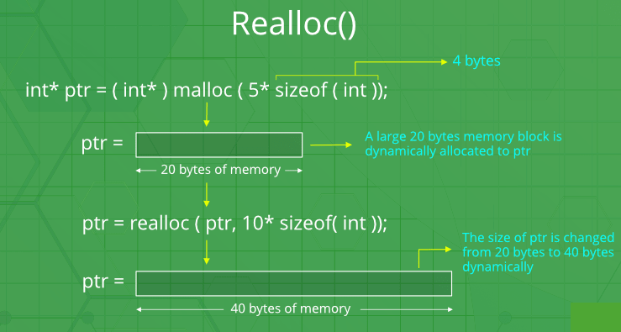

Slide 60
Infix to Postfix
Algorithm 1. Scan the infix expression from left to right. 2. If the scanned character is an operand, output it. 3. Else, 1 If the precedence of the scanned operator is greater than the precedence of the operator in the stack(or the stack is empty or the stack contains a ‘(‘ ), push it. 2 Else, Pop all the operators from the stack which are greater than or equal to in precedence than that of the scanned operator. After doing that Push the scanned operator to the stack. (If you encounter parenthesis while popping then stop there and push the scanned operator in the stack.) 4. If the scanned character is an ‘(‘, push it to the stack. 5. If the scanned character is an ‘)’, pop the stack and output it until a ‘(‘ is encountered, and discard both the parenthesis. 6. Repeat steps 2-6 until infix expression is scanned. 7. Print the output 8. Pop and output from the stack until it is not empty.

Slide 61
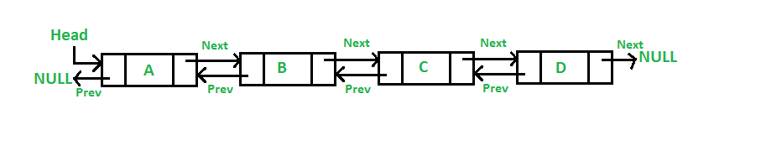
Doubly Linked List
A Doubly Linked List (DLL) contains an extra pointer, typically called previous pointer, together with next pointer and data which are there in singly linked list.

Slide 62
Advantages over singly linked list 1) A DLL can be traversed in both forward and backward direction. 2) The delete operation in DLL is more efficient if pointer to the node to be deleted is given. 3) We can quickly insert a new node before a given node. In singly linked list, to delete a node, pointer to the previous node is needed. To get this previous node, sometimes the list is traversed. In DLL, we can get the previous node using previous pointer.

Slide 63
Disadvantages over singly linked list 1) Every node of DLL Require extra space for an previous pointer. It is possible to implement DLL with single pointer though 2) All operations require an extra pointer previous to be maintained. For example, in insertion, we need to modify previous pointers together with next pointers.

Slide 64
Creating a Node in Doubly Linked List
Each node in a doubly linked list has data as well pointers. Therefore, we use a structure to create the node. The structure template for the node looks as follows:
struct Node
{
int data; //The data point
struct Node *Prev; //Pointer to the previous node
struct Node *Next; //Pointer to the next node
};

Slide 65
Traversal in a Doubly Linked List
List_traversal(struct Node *Head)
{
Prev = (struct Node *)malloc(sizeof(struct Node));
Next = (struct Node *)malloc(sizeof(struct Node));
if(Head == NULL) //If the list is empty
return;
while(Next->data != NULL)
{
Print(Next->data); //The display operation
Next = Next->data;
}
}

Slide 66
Insertion A node can be added in four ways 1) At the front of the DLL 2) After a given node. 3) At the end of the DLL 4) Before a given node.

Slide 67
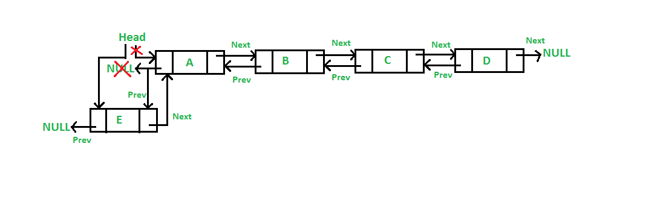
Insert a node at front (5 Steps)
/* Given a reference (pointer to pointer) to the head of a list
and an int, inserts a new node on the front of the list. */
void push(struct Node** head_ref, int new_data)
{
/* 1. allocate node */
struct Node* new_node = (struct Node*)malloc(sizeof(struct Node));
/* 2. put in the data */
new_node->data = new_data;
/* 3. Make next of new node as head and previous as NULL */
new_node->next = (*head_ref);
new_node->prev = NULL;
/* 4. change prev of head node to new node */
if ((*head_ref) != NULL)
(*head_ref)->prev = new_node;
/* 5. move the head to point to the new node */
(*head_ref) = new_node;
}

Slide 68
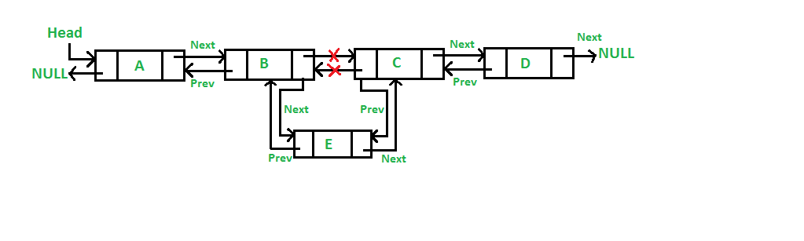
Add a node after a given node

Slide 69
/* Given a node as prev_node, insert a new node after the given node */
void insertAfter(struct Node* prev_node, int new_data)
{
/*1. check if the given prev_node is NULL */
if (prev_node == NULL) {
printf("the given previous node cannot be NULL");
return;
}
/* 2. allocate new node */
struct Node* new_node = (struct Node*)malloc(sizeof(struct Node));
/* 3. put in the data */
new_node->data = new_data;
/* 4. Make next of new node as next of prev_node */
new_node->next = prev_node->next;
/* 5. Make the next of prev_node as new_node */
prev_node->next = new_node;
/* 6. Make prev_node as previous of new_node */
new_node->prev = prev_node;
/* 7. Change previous of new_node's next node */
if (new_node->next != NULL)
new_node->next->prev = new_node;
}

Slide 70
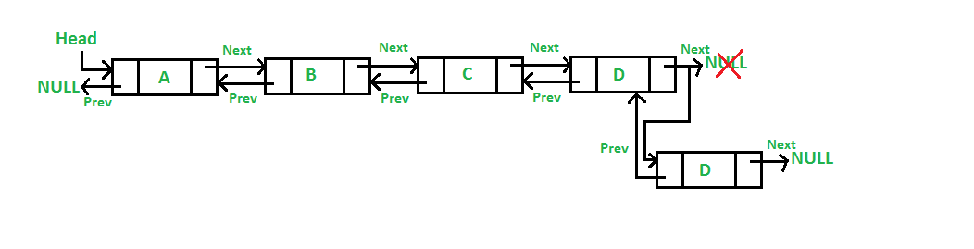
Add a node at the end

Slide 71
void append(struct Node** head_ref, int new_data)
{
/* 1. allocate node */
struct Node* new_node = (struct Node*)malloc(sizeof(struct Node));
struct Node* last = *head_ref;
/* used in step 5*/
/* 2. put in the data */
new_node->data = new_data;
/* 3. This new node is going to be the last
node, so make next of it as NULL*/
new_node->next = NULL;
/* 4. If the Linked List is empty, then make the new
node as head */
if (*head_ref == NULL) {
new_node->prev = NULL;
*head_ref = new_node;
return;
}
/* 5. Else traverse till the last node */
while (last->next != NULL)
last = last->next;
/* 6. Change the next of last node */
last->next = new_node;
/* 7. Make last node as previous of new node */
new_node->prev = last;
return;
}

Slide 72
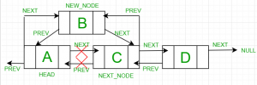
Add a node before a node

Slide 73
Add a node before a node
Let the pointer to this given node be next_node and the data of the new node to be added as new_data.
Check if the next_node is NULL or not. If it’s NULL, return from the function because any new node can not be added before a NULL
Allocate memory for the new node, let it be called new_node
Set new_node->data = new_data
Set the previous pointer of this new_node as the previous node of the next_node, new_node->prev = next_node->prev
Set the previous pointer of the next_node as the new_node, next_node->prev = new_node
Set the next pointer of this new_node as the next_node, new_node->next = next_node;
If the previous node of the new_node is not NULL, then set the next pointer of this previous node as new_node, new_node->prev->next = new_node
Else, if the prev of new_node is NULL, it will be the new head node. So, make (*head_ref) = new_node.

Slide 74
Deletion from a Linked List
1. Deletion from beginning
2. Deletion at the end
3. Deleting a node other than the first and the last node

Slide 75
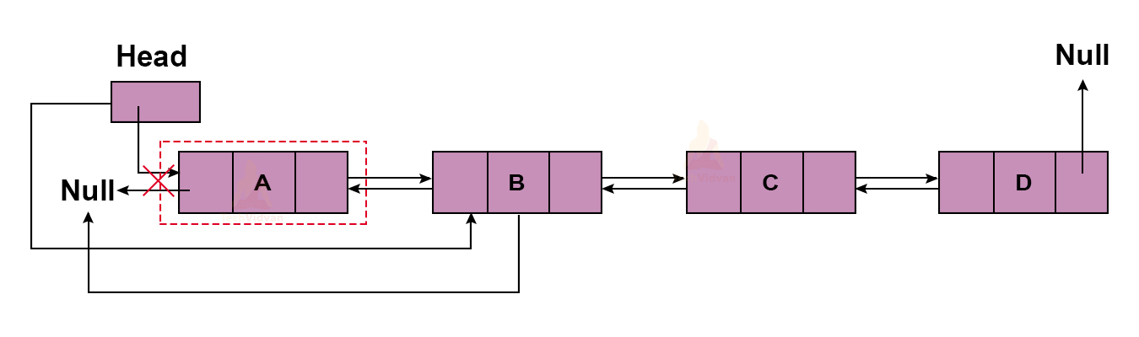
Deletion from the beginning
Algorithm to delete node from beginning
%% Input: head {Pointer to first node of the linked list}
Begin:
If (head == NULL) then
write ('Can't delete from an empty list')
End if
Else then
toDelete ← head;
head ← head.next;
head.prev ← NULL;
unalloc (toDelete)
write ('Successfully deleted first node from the list')
End if
End

Slide 76
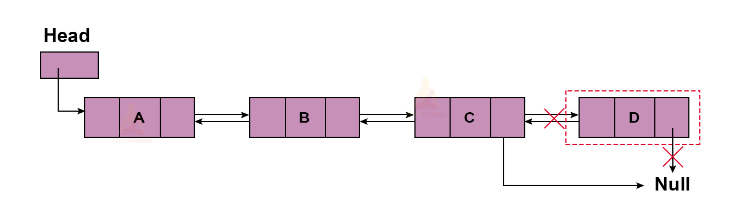
Deletion at the end
Algorithm to delete node from end
%% Input: last {Pointer to last node of the linked list}
Begin:
If (last == NULL) then
write ('Can't delete from an empty list')
End if
Else then
toDelete ← last;
last ← last.prev;
last.next ← NULL;
unalloc (toDelete)
write ('Successfully deleted last node from the list')
End if
End

Slide 77
Algorithm to delete node from any position of a doubly linked list
Algorithm to delete node from any position
%% Input : head {Pointer to the first node of the list}
last {Pointer to the last node of the list}
N {Position to be deleted from list}
Begin:
current ← head;
For i ← 1 to N and current != NULL do
current ← current.next;
End for
If (N == 1) then
deleteFromBeginning()
End if
Else if (current == last) then
deleteFromEnd()
End if
Else if (current != NULL) then
current.prev.next ← current.next
If (current.next != NULL) then
current.next.prev ← current.prev;
End if
unalloc (current)
write ('Node deleted successfully from ', N, ' position')
End if
Else then
write ('Invalid position')
End if
End

Slide 79
Circular Linked List
Circular Linked List

